Slide 1
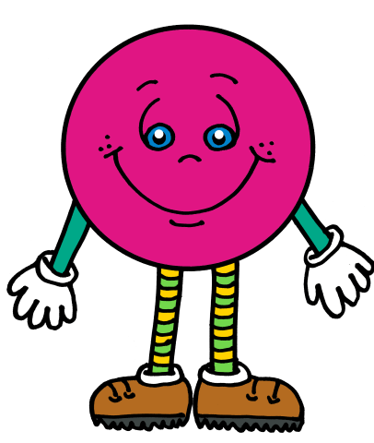
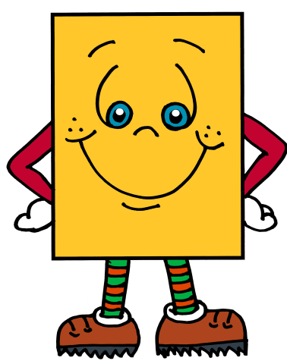
Module 6
Building and Drawing
Flat and Solid Shapes

Slide 2
Lesson Links Click on the lesson you want to go to! (You must be in Slide Show/Presentation Mode.)
Lesson 1 Lesson 5 Lesson 2 Lesson 6 Lesson 3 Lesson 7 Lesson 4 Lesson 8

Slide 3
Lesson 1
I can describe how to build flat shapes.

Slide 4
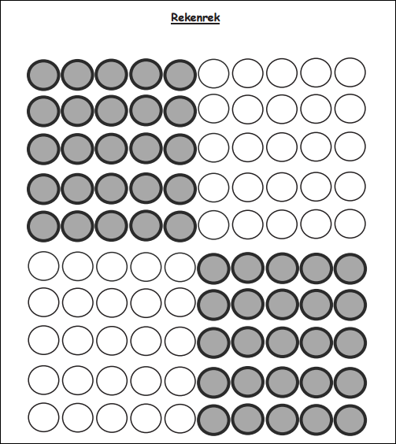
Module 6, Lesson 1
Fluency
Count to 100 by Ones
Count to 100 (or as high as you can) in 3 minutes by touching the beads on the Rekenrek dot paper. Say “buzz” after the last number of each row.

Slide 5
Module 6, Lesson 1
Fluency
If You’re Happy and You Know It
Let’s sing! We’ll sing the song three times and use a different movement each time. Then, we’ll sing it a final time and put all three movements together. Ready?
Verse 1: If you’re happy and you know it, clap your hands.
Verse 2: If you’re happy and you know it, stomp your feet.
Verse 3: If you’re happy and you know it, shout “horray.”
Verse 4: If you’re happy and you know it, do all three.

Slide 6
Module 6, Lesson 1
Fluency
Peek-a-Boo Shapes
I’m going to show you a shape, but only for a second! Use the listen, think, raise your hand, and wait for the snap procedure to name the shape.

Slide 7
Module 6, Lesson 1
Fluency
Peek-a-Boo Shapes
I’m going to show you a shape, but only for a second! Use the listen, think, raise your hand, and wait for the snap procedure to name the shape.

Slide 8
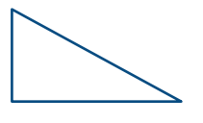
Module 6, Lesson 1
Fluency
Peek-a-Boo Shapes
I’m going to show you a shape, but only for a second! Use the listen, think, raise your hand, and wait for the snap procedure to name the shape.

Slide 9
Module 6, Lesson 1
Fluency
Peek-a-Boo Shapes
I’m going to show you a shape, but only for a second! Use the listen, think, raise your hand, and wait for the snap procedure to name the shape.

Slide 10
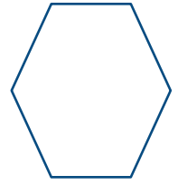
Module 6, Lesson 1
Fluency
Peek-a-Boo Shapes
I’m going to show you a shape, but only for a second! Use the listen, think, raise your hand, and wait for the snap procedure to name the shape.

Slide 11
Module 6, Lesson 1
Fluency
Peek-a-Boo Shapes
I’m going to show you a shape, but only for a second! Use the listen, think, raise your hand, and wait for the snap procedure to name the shape.

Slide 12
Module 6, Lesson 1
Fluency
Peek-a-Boo Shapes
I’m going to show you a shape, but only for a second! Use the listen, think, raise your hand, and wait for the snap procedure to name the shape.

Slide 13
Module 6, Lesson 1
Fluency
Peek-a-Boo Shapes
I’m going to show you a shape, but only for a second! Use the listen, think, raise your hand, and wait for the snap procedure to name the shape.

Slide 14
Module 6, Lesson 1
Fluency
Peek-a-Boo Shapes
I’m going to show you a shape, but only for a second! Use the listen, think, raise your hand, and wait for the snap procedure to name the shape.

Slide 15
Application Problem
Module 6, Lesson 1
We are going to be talking about shapes again! Draw several things you saw this past week that looked like shapes you know. What are the different shapes called?

Slide 16
Module 6, Lesson 1
Listen to my directions.
First, stand up.
Second, put your hands on your shoulders.

Slide 17
Module 6, Lesson 1
What did I ask you to do first?
What was the second thing I
asked you to do?
Good! Please sit down.

Slide 18
Module 6, Lesson 1
Listen to my directions.
First, stand up.
Second, put your hands on your shoulders.
Third, jump up and down 3 times.
Please sit down.

Slide 19
Module 6, Lesson 1
What did I ask you to do first?
What was the second thing I
asked you to do?
And the third thing?

Slide 20
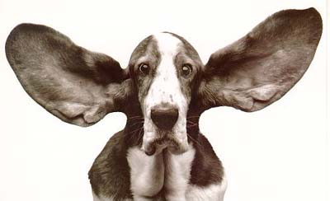
Module 6, Lesson 1
Let’s play one more time!
Listen carefully!
First, clap two times.
Second, stomp 3 times.
Third, shout “Hooray!” once.
Please sit down.

Slide 21
Module 6, Lesson 1
What did I ask you to do first?
What was the second thing I
asked you to do?
And the third thing?

Slide 22
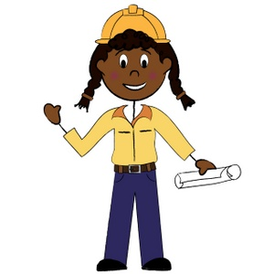
Module 6, Lesson 1
You are going to be builders today!
We are going to make shapes. Look at the materials you have. What do you notice?

Slide 23
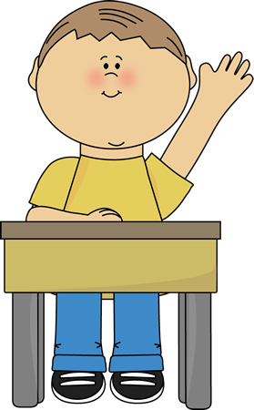
Module 6, Lesson 1
Pick up your sticks, and arrange them on your desk. Try to make a shape. Who has an idea?

Slide 24
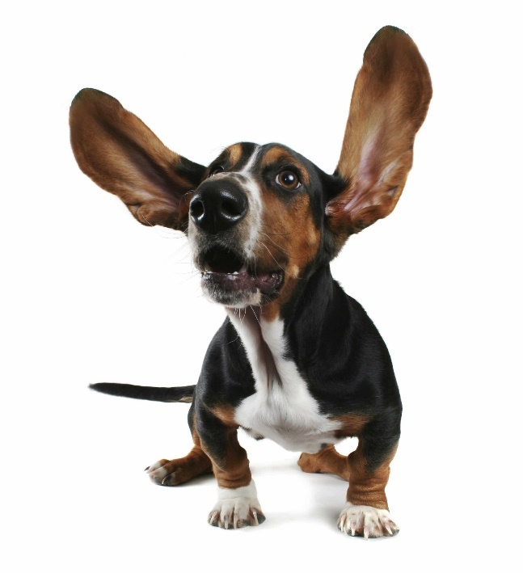
Module 6, Lesson 1
Let’s practice more shape making!
First, use your scissors to cut each of your sticks at the mark in the middle.
Second, arrange your little sticks to make different flat shapes.
Third, use bits of clay to connect the corners of your new shape.

Slide 25
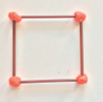
Module 6, Lesson 1
If you haven’t made a square yet, do so now. Then, you may experiment. How many different shapes can you make? We will have a shape show when you are done!

Slide 26
Module 6, Lesson 1
Listen again! Get your pencil and
construction paper ready.
First, put a dot on the left side of your paper. Watch me!
Second, draw a line that starts at that dot with your ruler. Watch me!
Third, draw another line that starts at that dot with your ruler. Watch me!
Listen again!
First, put a dot at the ends of both your lines. Watch me!
Second, draw a line with your ruler to connect those dots. Watch me!
Third, show your work to a friend, and tell them what shape you drew.

Slide 27
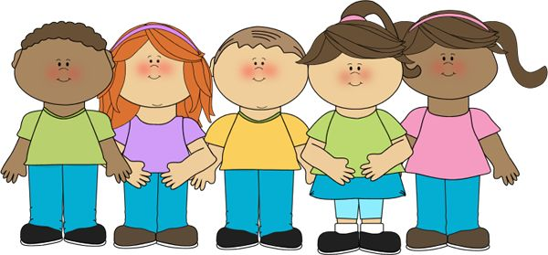
Module 6, Lesson 1
Now, share about all your shapes with your friends-
the ones you made with straws and the ones you made with your ruler.

Slide 28
Module 6, Lesson 1
Listen carefully!
First, put your name on your construction paper.
Second, carefully lift your shapes onto your paper, and leave them on your desk.
Third, stand up and get ready to look at the shapes the rest of the class created.

Slide 29
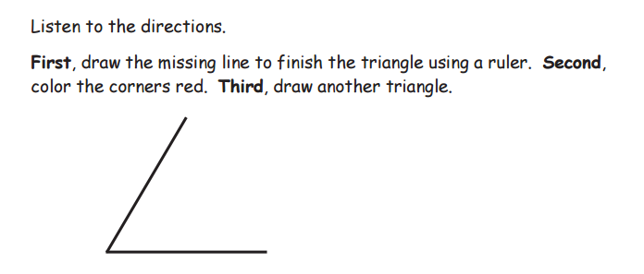

Slide 31
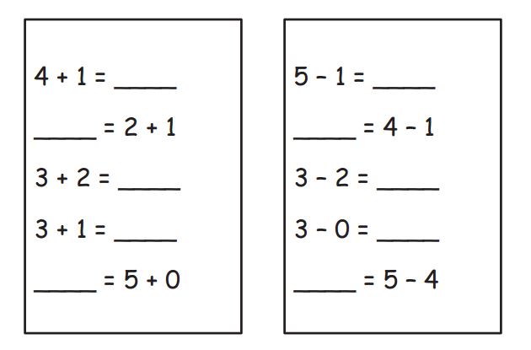

Slide 32
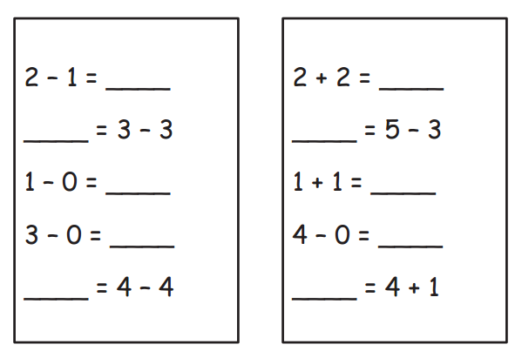

Slide 33
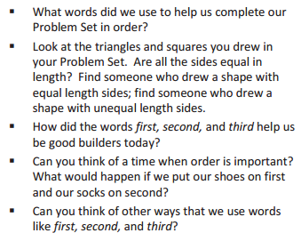
Debrief

Slide 34
Lesson 2
I can build flat shapes and record with drawings.

Slide 35
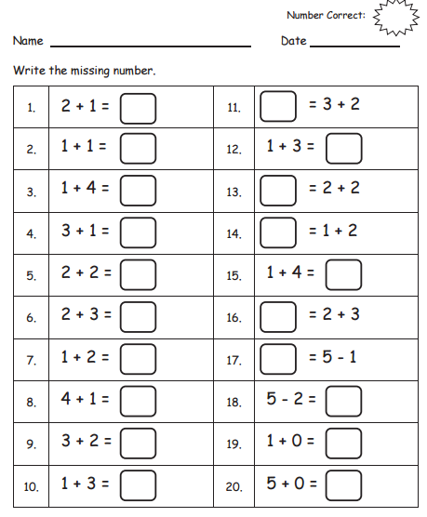
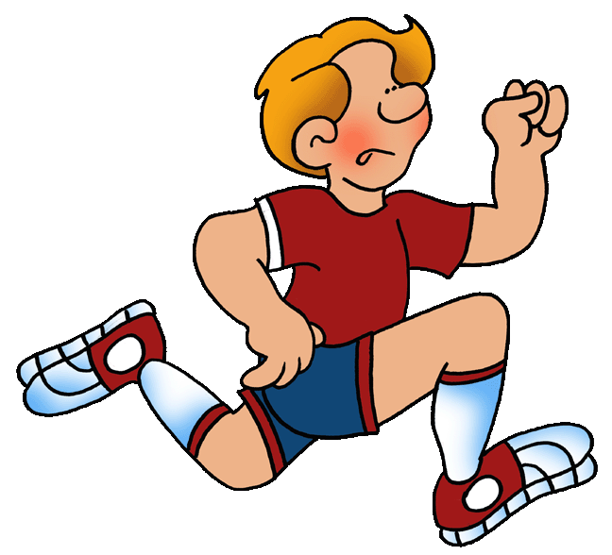
Core Fluency
Sprint A
Module 6, Lesson 2
Fluency

Slide 36
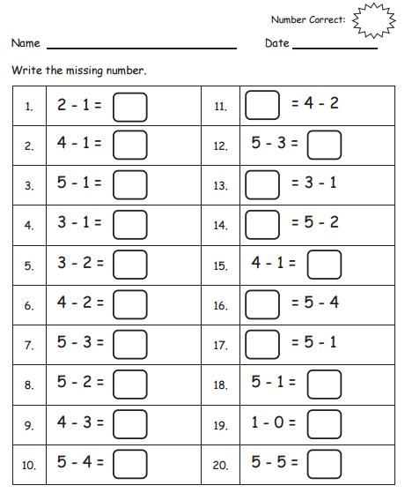
Core Fluency
Sprint B
Module 6, Lesson 2
Fluency

Slide 37
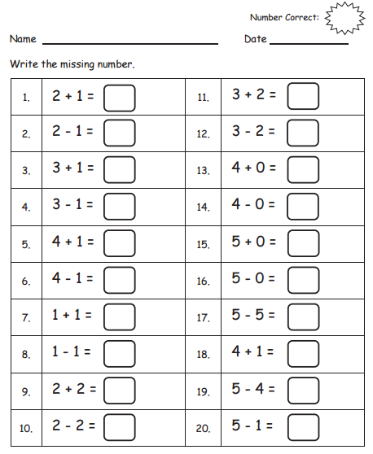
Core Fluency
Sprint C
Module 6, Lesson 2
Fluency

Slide 38
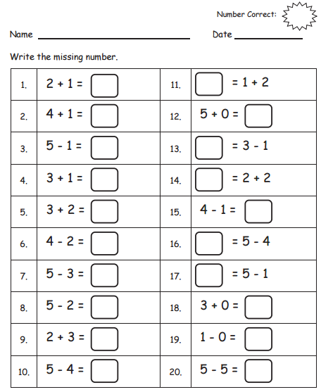
Core Fluency
Sprint D
Module 6, Lesson 2
Fluency

Slide 39
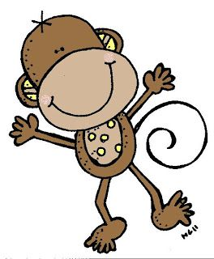
Module 6, Lesson 2
Fluency
Compose Teen Numbers
Raise your hand when you can say the number the Say Ten Way. Now, say it the regular way.
1 0
6

Slide 40
Module 6, Lesson 2
Fluency
Compose Teen Numbers
Raise your hand when you can say the number the Say Ten Way. Now, say it the regular way.
1 0
6

Slide 41
Module 6, Lesson 2
Fluency
Compose Teen Numbers
Raise your hand when you can say the number the Say Ten Way. Now, say it the regular way.
1 0
7

Slide 42
Module 6, Lesson 2
Fluency
Compose Teen Numbers
Raise your hand when you can say the number the Say Ten Way. Now, say it the regular way.
1 0
7

Slide 43
Module 6, Lesson 2
Fluency
Compose Teen Numbers
Raise your hand when you can say the number the Say Ten Way. Now, say it the regular way.
1 0
8

Slide 44
Module 6, Lesson 2
Fluency
Compose Teen Numbers
Raise your hand when you can say the number the Say Ten Way. Now, say it the regular way.
1 0
8

Slide 45
Module 6, Lesson 2
Fluency
Compose Teen Numbers
Raise your hand when you can say the number the Say Ten Way. Now, say it the regular way.
1 0
9

Slide 46
Module 6, Lesson 2
Fluency
Compose Teen Numbers
Raise your hand when you can say the number the Say Ten Way. Now, say it the regular way.
1 0
9

Slide 47
Module 6, Lesson 2
Fluency
Compose Teen Numbers
Raise your hand when you can say the number the Say Ten Way. Now, say it the regular way.
1 0
3

Slide 48
Module 6, Lesson 2
Fluency
Compose Teen Numbers
Raise your hand when you can say the number the Say Ten Way. Now, say it the regular way.
1 0
3

Slide 49
Module 6, Lesson 2
Fluency
Compose Teen Numbers
Raise your hand when you can say the number the Say Ten Way. Now, say it the regular way.
1 0
4

Slide 50
Module 6, Lesson 2
Fluency
Compose Teen Numbers
Raise your hand when you can say the number the Say Ten Way. Now, say it the regular way.
1 0
4

Slide 51
Module 6, Lesson 2
Fluency
Compose Teen Numbers
Raise your hand when you can say the number the Say Ten Way. Now, say it the regular way.
1 0
5

Slide 52
Module 6, Lesson 2
Fluency
Compose Teen Numbers
Raise your hand when you can say the number the Say Ten Way. Now, say it the regular way.
1 0
5

Slide 53
Module 6, Lesson 2
Fluency
Compose Teen Numbers
Raise your hand when you can say the number the Say Ten Way. Now, say it the regular way.
1 0
1

Slide 54
Module 6, Lesson 2
Fluency
Compose Teen Numbers
Raise your hand when you can say the number the Say Ten Way. Now, say it the regular way.
1 0
1

Slide 55
Module 6, Lesson 2
Fluency
Compose Teen Numbers
Raise your hand when you can say the number the Say Ten Way. Now, say it the regular way.
1 0
2

Slide 56
Module 6, Lesson 2
Fluency
Compose Teen Numbers
Raise your hand when you can say the number the Say Ten Way. Now, say it the regular way.
1 0
2

Slide 57
Module 6, Lesson 2
Fluency
Compose Teen Numbers
Raise your hand when you can say the number the Say Ten Way. Now, say it the regular way.
1 0
0

Slide 58
Module 6, Lesson 2
Fluency
Compose Teen Numbers
Raise your hand when you can say the number the Say Ten Way. Now, say it the regular way.
1 0
0

Slide 59
Module 6, Lesson 2
Fluency
Compose Teen Numbers
Raise your hand when you can say the number the Say Ten Way. Now, say it the regular way.
2 0
0

Slide 60
Module 6, Lesson 2
Fluency
Compose Teen Numbers
Raise your hand when you can say the number the Say Ten Way. Now, say it the regular way.
2 0
0

Slide 61
Module 6, Lesson 2
Who can remind us about what we did in our last math lesson? Can you use your math words to tell us, in order, the steps that we took in our lesson?

Slide 62
Module 6, Lesson 2
We are going to make more flat shapes today. In our last lesson we made special rectangles that had equal sides. What did we call them?

Slide 63
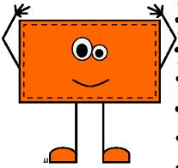
Module 6, Lesson 2
Today, use your sticks and your clay to create another type of rectangle- one that has corners like and L but whose sides are not all the same length.
You may cut one or two of your sticks if you need to.

Slide 64
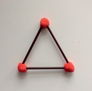
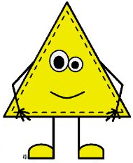
Module 6, Lesson 2
Take three sticks that are the same length. Now, use those sticks to make a closed shape with
three straight sides.
What do you call this shape?

Slide 65
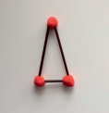
Module 6, Lesson 2
What if you take one of the sides of your triangle and cut it to be shorter, and then put it back into your shape?
What do you notice?

Slide 66
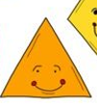
Module 6, Lesson 2
With your partner, use your sticks and your clay to make several different flat shapes. You may cut the sticks to be any length you like. Be creative!

Slide 67
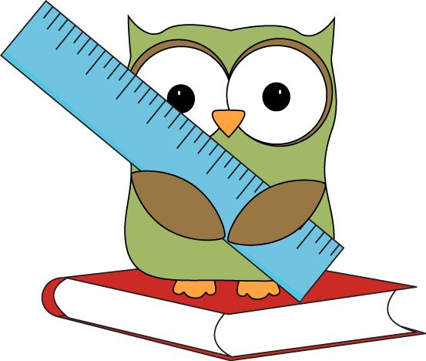
Module 6, Lesson 2
Would anyone like to show their favorite shape and tell the class about it?
With you ruler and your marker, try to copy each of your new shapes on your personal white board!

Slide 68
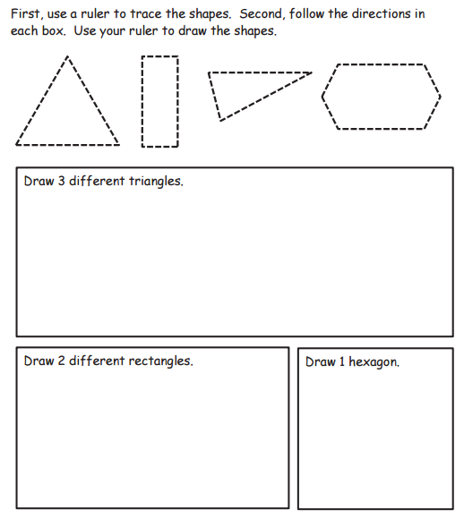

Slide 69
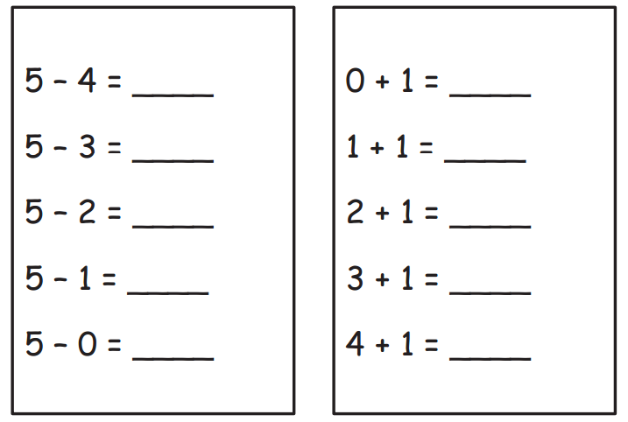

Slide 70
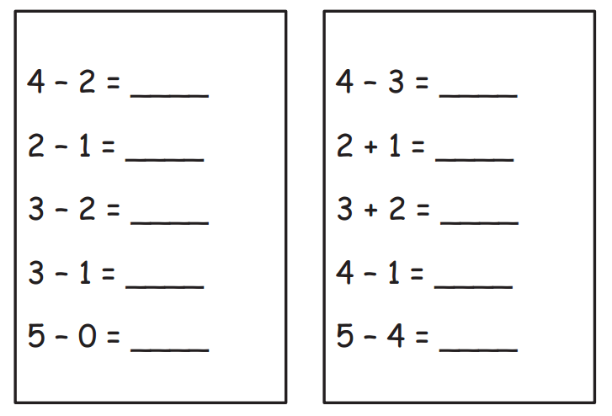

Slide 71
Debrief

Slide 72
Lesson 3
I can compose solids using flat shapes as a foundation.

Slide 73
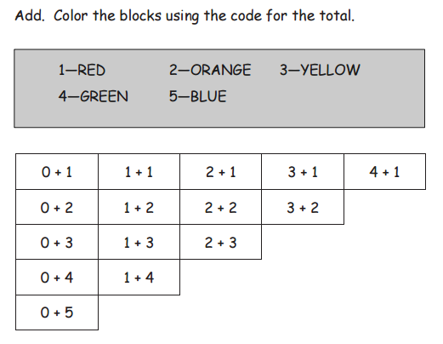
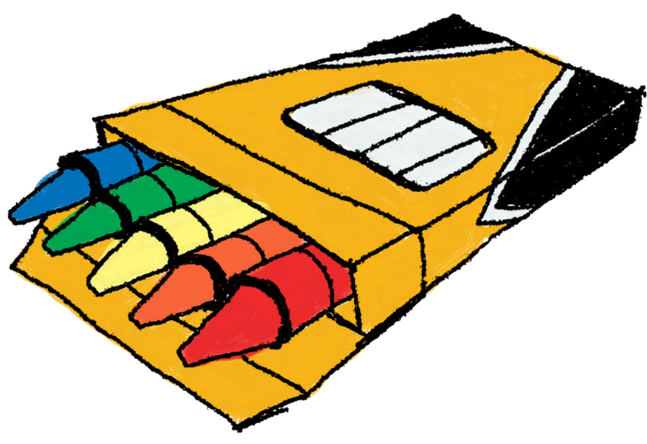
Module 6, Lesson 3
Fluency
Color by Answer Addition
Let’s do a couple together. Then, you will finish on your own.

Slide 74
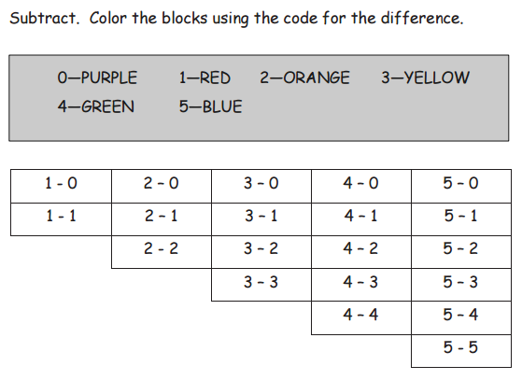
Module 6, Lesson 3
Fluency
Color by Answer Subtraction
Let’s do a couple together. Then, you will finish on your own.

Slide 75
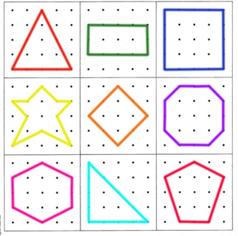
Application Problem
Module 6, Lesson 3
Try it with five sides! Then, six! How far can you and your partner go?
Now, make a shape with four sides. Have your partner make another four-sided shape. Do they look alike? Name the shapes. Remove your shapes from the geoboard.
You have a challenge today! Work with your partner. On your geoboard, make a shape with three sides. Now, leave your shape on your board, and let your partner make a three-sided shape as well. Do they look the same? Name the shapes. Remove your shapes from the geoboard.

Slide 76
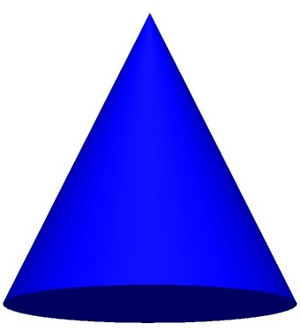
Module 6, Lesson 3
How do you know?
What is special about a cone?
What do we call this solid?

Slide 77
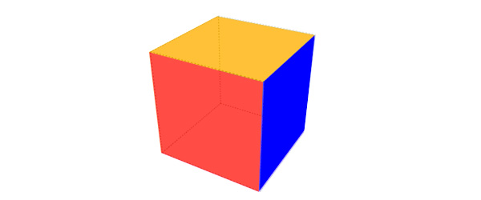
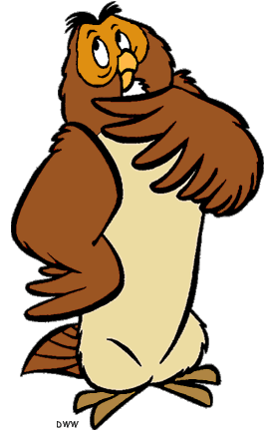
Module 6, Lesson 3
How do you know?
What is special about a cube?
What do we call this solid?

Slide 78
Module 6, Lesson 3
How do you know?
What is special about a sphere?
What do we call this solid?

Slide 79
Module 6, Lesson 3
How do you know?
What is special about a cylinder?
What do we call this solid?

Slide 80
Module 6, Lesson 3
In our last lesson, you made some great shapes out of your straws! I want to use some of the squares you constructed to make a new shape like one of our solids. Does anyone have any ideas?
I do!

Slide 81
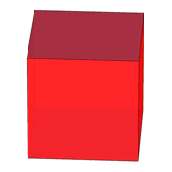
Module 6, Lesson 3
Look at the cube. How many squares will I need to use? Let’s count!
Watch me make
a cube with your squares!

Slide 82
Module 6, Lesson 3
How can I fix it so it doesn’t look like a
skeleton cube? Let’s give it some faces!
How many faces does our cube have?
Let’s count!
How many edges does it have?
Let’s count!
How many corners does it have?
Let’s count!

Slide 83
Module 6, Lesson 3
It’s time to make a shape like this on your own! Begin by making a square out of your straws for the bottom. Make another one for the top, too.
What do we need now? Finish your shapes!

Slide 84
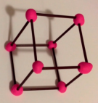
Module 6, Lesson 3
What do you notice about your shapes?
Work with your partner to count the faces, edges, and corners of your pretend cube like
we did earlier.

Slide 85
Module 6, Lesson 3
I wonder what would happen if we put two of these shapes together. With your partner, see what you can create if you use more than one.

Slide 86
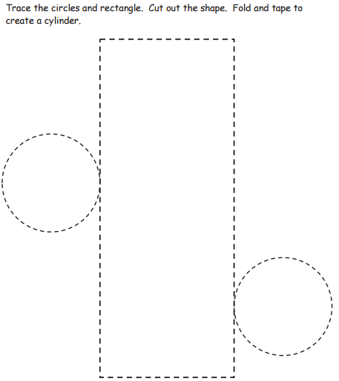

Slide 87
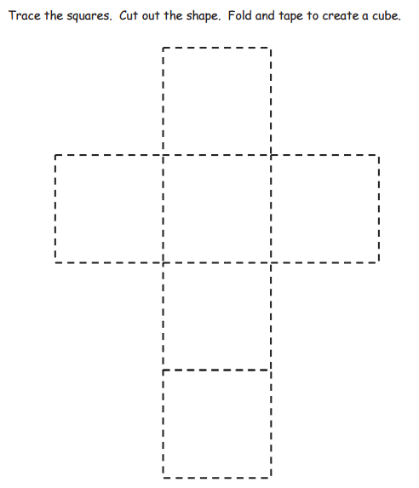

Slide 88
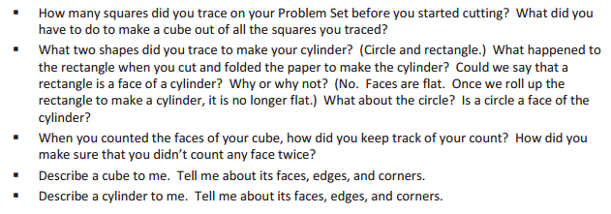
Debrief

Slide 89
Lesson 4
I can describe the position of shapes.

Slide 90
Module 6, Lesson 4
Fluency
Rekenrek Counting to 100
Let’s count the Say Ten Way. Ready?

Slide 91
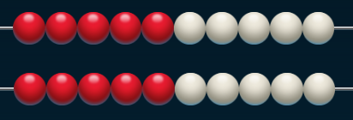
Module 6, Lesson 4
Fluency
Rekenrek Counting to 100

Slide 92
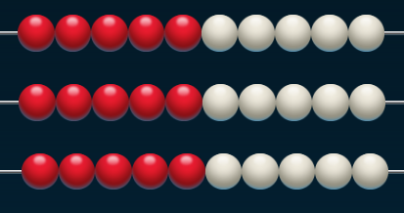
Module 6, Lesson 4
Fluency
Rekenrek Counting to 100

Slide 93
Module 6, Lesson 4
Fluency
Rekenrek Counting to 100

Slide 94
Module 6, Lesson 4
Fluency
Rekenrek Counting to 100

Slide 95
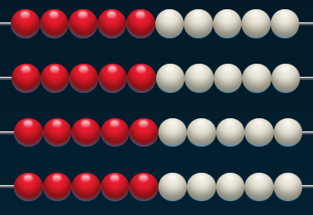
Module 6, Lesson 4
Fluency
Rekenrek Counting to 100

Slide 96
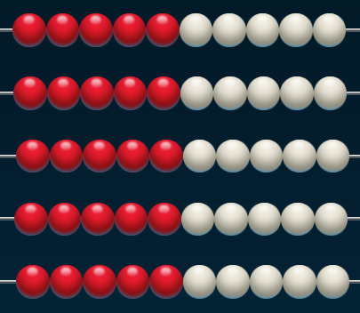
Module 6, Lesson 4
Fluency
Rekenrek Counting to 100

Slide 97
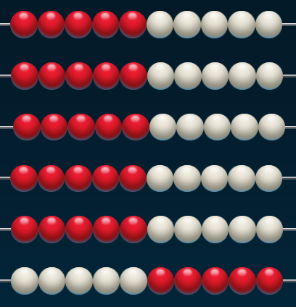
Module 6, Lesson 4
Fluency
Rekenrek Counting to 100

Slide 98
Module 6, Lesson 4
Fluency
Rekenrek Counting to 100

Slide 99
Module 6, Lesson 4
Fluency
Rekenrek Counting to 100

Slide 100
Module 6, Lesson 4
Fluency
Rekenrek Counting to 100

Slide 101
Module 6, Lesson 4
Fluency
Rekenrek Counting to 100

Slide 102
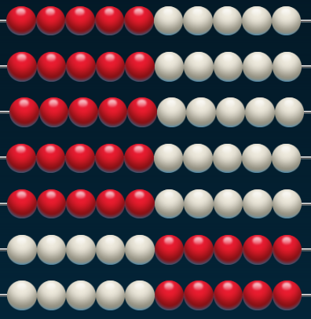
Module 6, Lesson 4
Fluency
Rekenrek Counting to 100

Slide 103
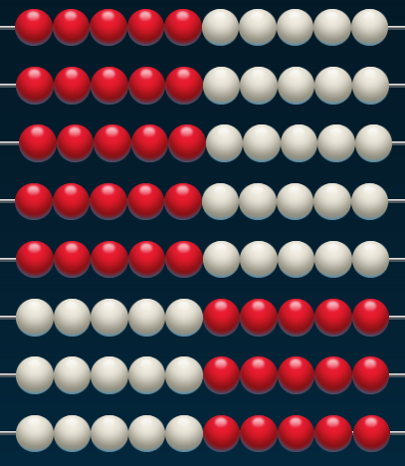
Module 6, Lesson 4
Fluency
Rekenrek Counting to 100

Slide 104
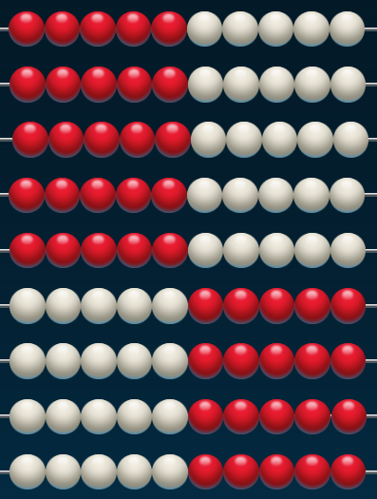
Module 6, Lesson 4
Fluency
Rekenrek Counting to 100

Slide 105
Module 6, Lesson 4
Fluency
Rekenrek Counting to 100

Slide 106
Module 6, Lesson 4
Fluency
Rekenrek Counting to 100

Slide 107
Module 6, Lesson 4
Fluency
Rekenrek Counting to 100
10 tens is the same as…?

Slide 108
Module 6, Lesson 4
Fluency
Rekenrek Counting to 100
Wow! You’re getting good at counting both ways! Now, let’s mix it up. Start counting the Say Ten Way, but then be ready to switch to the regular way.

Slide 109
Module 6, Lesson 4
Fluency
Rekenrek Counting to 100

Slide 110
Module 6, Lesson 4
Fluency
Rekenrek Counting to 100

Slide 111
Module 6, Lesson 4
Fluency
Rekenrek Counting to 100
3 tens is the regular way is…?
Keep counting the regular way.

Slide 112
Module 6, Lesson 4
Fluency
Rekenrek Counting to 100

Slide 113
Module 6, Lesson 4
Fluency
Rekenrek Counting to 100

Slide 114
Module 6, Lesson 4
Fluency
Rekenrek Counting to 100

Slide 115
Module 6, Lesson 4
Fluency
Rekenrek Counting to 100
60 the Say Ten Way is…?
Keep going the Say Ten Way.

Slide 116
Module 6, Lesson 4
Fluency
Rekenrek Counting to 100

Slide 117
Module 6, Lesson 4
Fluency
Rekenrek Counting to 100

Slide 118
Module 6, Lesson 4
Fluency
Rekenrek Counting to 100

Slide 119
Module 6, Lesson 4
Fluency
Rekenrek Counting to 100
9 tens the regular way is…?
Say the next number the regular way.

Slide 120
Module 6, Lesson 4
Fluency
Rekenrek Counting to 100
Now, let’s count down! Start the regular way.

Slide 121
Module 6, Lesson 4
Fluency
Rekenrek Counting to 100

Slide 122
Module 6, Lesson 4
Fluency
Rekenrek Counting to 100

Slide 123
Module 6, Lesson 4
Fluency
Rekenrek Counting to 100

Slide 124
Module 6, Lesson 4
Fluency
Rekenrek Counting to 100
70 the Say Ten Way is…?
Keep going the Say Ten Way.

Slide 125
Module 6, Lesson 4
Fluency
Rekenrek Counting to 100

Slide 126
Module 6, Lesson 4
Fluency
Rekenrek Counting to 100

Slide 127
Module 6, Lesson 4
Fluency
Rekenrek Counting to 100

Slide 128
Module 6, Lesson 4
Fluency
Rekenrek Counting to 100
4 tens the regular way is…?
Keep going the regular way.

Slide 129
Module 6, Lesson 4
Fluency
Rekenrek Counting to 100

Slide 130
Module 6, Lesson 4
Fluency
Rekenrek Counting to 100

Slide 131
Module 6, Lesson 4
Fluency
Rekenrek Counting to 100

Slide 132
Module 6, Lesson 4
Fluency
Make a Shape to Find Hidden Numbers in 4
Raise your hand when you know how many dots. Raise you hand when you know the name of this shape. Very good! We’re going to use puzzle pieces to make a square and, at the same time, show different ways to make 4.

Slide 133
Module 6, Lesson 4
Fluency
Make a Shape to Find Hidden Numbers in 4
How many dots are on the first puzzle piece?
And on the other one?

Slide 134
Module 6, Lesson 4
Fluency
Make a Shape to Find Hidden Numbers in 4
On the whole puzzle? So then what numbers are hiding in 4? What shapes did I use to make the square? Do you see other puzzle pieces I could use to make a square that has 4 dots? Give it a try!

Slide 135
Module 6, Lesson 4
Fluency
Make a Shape to Find Hidden Numbers in 5
Now, try to make a shape with 5 dots. Look at my example. What numbers are hiding in 5? What shape did I make? Now, you try it!

Slide 136
Application Problem
Module 6, Lesson 4
First, draw 3 three-sided shapes on your personal white board.
Second, draw 4 four-sided shapes on your paper.
Third, draw a number bond, and write a number sentence to tell how many shapes you have in all.

Slide 137
Module 6, Lesson 4
How many shapes do you see on your paper? Raise your hand when you know. Call it out at my signal.
Cut out each shape card on the dotted lines.

Slide 138
Module 6, Lesson 4
Make a row out of your shapes in any order.

Slide 139
Module 6, Lesson 4
Rearrange your shapes so that the first shape from the left is a circle.
LEFT
RIGHT

Slide 140
Module 6, Lesson 4
Make your second shape the smaller triangle. Keep your row straight!

Slide 141
Module 6, Lesson 4
Now, arrange it so that your third shape is a circle with a chunk missing. Share with your partner. What is the next shape in your row?

Slide 142
Module 6, Lesson 4
Student A, count your shapes starting from the left, stopping at the cross.
My _________ shape is __________.
LEFT
RIGHT

Slide 143
Module 6, Lesson 4
Student B, count your shapes starting at the left and stop at your last shape.
My _________ shape is __________.
LEFT
RIGHT

Slide 144
Module 6, Lesson 4
Mix up all your shapes again. This time, we are going to make a column of your shapes. Our columns will be all the same, so listen carefully.
Make the first shape, the one at the top of your column, a square.
Second, the large triangle.
Third, a cross.
Fourth, a circle.
Fifth, a heart.
Sixth, the hexagon.
Seventh, the circle with a chunk out of it.
Eighth, the small triangle.
Ninth, the diamond (rhombus).
Tenth, the one that looks like part of a can.

Slide 145
Module 6, Lesson 4
Count from the top, and then put your finger on the last shape in your column.
How many shapes did you count?
My tenth shape is __________.

Slide 146
Module 6, Lesson 4
Start at the top of your column, and count down 5 shapes. What is your fifth shape?
My fifth shape is __________.

Slide 147
Module 6, Lesson 4
My third shape is __________.
My sixth shape is __________.
My second shape is __________.
My eighth shape is __________.
My first shape is __________.
My fourth shape is __________.
My seventh shape is __________.

Slide 148
Module 6, Lesson 4
We are going to play Simon Says
with your shapes!
Simon Says, make a row of shapes.
Simon Says, make your sixth shape a heart.
Simon Says, make your ninth shape a square.
Simon Says, make sure that your first shape is a triangle.
Put your finger on the third shape.
Simon Says, make your seventh shape a circle.
Make your second shape a diamond (rhombus).
Simon Says, tell your partner about your column of shapes using math words to describe the position of each shape in the line.

Slide 152
Debrief

Slide 153
Lesson 5
I can compose flat shapes using pattern blocks and drawings.

Slide 154
Core Fluency
Sprint A
Module 6, Lesson 5
Fluency

Slide 155
Core Fluency
Sprint B
Module 6, Lesson 5
Fluency

Slide 156
Core Fluency
Sprint C
Module 6, Lesson 5
Fluency

Slide 157
Core Fluency
Sprint D
Module 6, Lesson 5
Fluency

Slide 158
Module 6, Lesson 5
Fluency
Finish Line
How many cubes do you have? Pretend that your 10-stick of cubes is a little train. Put your finger on the first cube. Let’s use our number order words as we touch each cube. Ready?

Slide 159
Module 6, Lesson 5
Fluency
Finish Line
Now, break apart your cubes so none are connected. This time, I want you to pretend that they are little people running in a race. The start line is the end of your personal white board. The finish line is the opposite side of your board. Now, make your people run until I say stop….”STOP!” The race is over. Get out your marker. Listen carefully. Circle the first runner. Make an X next to the tenth runner. Underline the fifth runner. Now, point and show your partner who is first, second, and so on.

Slide 160
Application Problem
Module 6, Lesson 5
Listen carefully to my instructions. You are
going to draw a house!
First, draw a square to make the big part of your house.
Second, use a triangle to make a roof.
Third, use a shape of your choice for a door.
Fourth, find somewhere in your picture where you can use two more squares or rectangles.
Fifth, use a circle somewhere in your scene.
Sixth, find a place where you could draw a hexagon in your scene.
Now, take another minute to finish your scene with more shapes and details. Don’t forget to draw yourself!

Slide 161
Module 6, Lesson 5
Find two squares in your pattern block box.
How do you know they are squares?

Slide 162
Module 6, Lesson 5
Put your squares back inside your new shape outline. I wonder what would happen if we added another square? Try it and see!
Place the squares on your personal white board. See if you can make a different rectangle from your squares.
Hold your pattern blocks down and trace your new shape with your marker.
Take out one more square. Can you use the four small squares to make a larger square?

Slide 163
Module 6, Lesson 5
Let’s try another one! Take a square and a triangle out of your pattern block box. On your board, find a way to put their sides together to make a new shape.
Trace your pattern blocks to show your new shape.

Slide 164
Module 6, Lesson 5
Now, you’re going to get a chance to make up your own new shapes! Work with your partner, taking turns to be the shape artist.
First, choose two shapes from your pattern block box.
Second, put them together to make a new shape.
Third, trace your shape on your recording sheet.
Fourth, tell your partner about your new shape. How many sides does it have? How many corners? What would you name your new shape?

Slide 168
Debrief

Slide 169
Lesson 6
I can decompose flat shapes into two or more shapes.

Slide 170
Make 10
Sprint
Module 6, Lesson 6
Fluency

Slide 171
Application Problem
Module 6, Lesson 6
You are going to be a detective today!
First, look around the classroom to see if you can find things made of more than one shape, like we did yesterday.
Second, draw one thing on your personal white board.
Third, use your marker to draw the shapes inside.

Slide 172
Module 6, Lesson 6
What do you see on your paper?
Cut out your shapes, and talk about them with your friends. Do not cut on the dotted line.

Slide 173
Module 6, Lesson 6
Hold up your gray square.

Slide 174
Module 6, Lesson 6
Hold up your white triangle.

Slide 175
Module 6, Lesson 6
Put your white triangle on your gray square, making two of the sides match.
What do you
notice?

Slide 176
Module 6, Lesson 6
Find your gray rectangle with and your white square.

Slide 177
Module 6, Lesson 6
What happens if we cover as much as we can of the gray rectangle with the square?

Slide 178
Module 6, Lesson 6
Hold up your white and gray triangles. Put them together. What shapes can you make with them?

Slide 179
Module 6, Lesson 6
Fold your gray triangle on the dotted line.
What do you notice?

Slide 180
Module 6, Lesson 6
Now, look at your white rectangle with the dotted line. Fold it on the dotted line.
Is there another way you could fold it?

Slide 181
Module 6, Lesson 6
Now, take your large gray square, and fold it on the dotted line. What shapes do you see.

Slide 182
Module 6, Lesson 6
You found a lot of little shapes inside the other ones. What does this make you think of?
Just like we can break our numbers into smaller parts, we can make smaller shapes out of bigger shapes, too!

Slide 183
Module 6, Lesson 6
Yesterday, you made some wonderful new shapes on your recording sheet. Today, you are going to trade sheets with your partner to see if you can use pattern blocks to fill in the new shapes she made. If you need help, ask your partner! Take turns being the teacher!

Slide 187
Debrief

Slide 188
Lesson 7
I can compose simple shapes to form a larger shape.

Slide 189
Module 6, Lesson 7
Fluency
Getting Ready for First Grade!
It’s very important that you continue to practice math over the summer. You will be getting some things today to take home and use over the summer to help you get ready for first grade. You will get a letter telling parents and families how they can help.

Slide 190
Application Problem
Module 6, Lesson 7
Pretend you are having a party. Draw a big rectangle on your personal white board to show a delicious pretend chocolate cake. Now, use your ruler, and draw lines to show how you would slice it to share the cake with the party guests. Where would you draw the lines? How many pieces did you make?

Slide 191
Module 6, Lesson 7
What do you see on your paper?

Slide 192
Module 6, Lesson 7
Today, you are going to be puzzle makers!
Your first job is to cut the paper down the dotted line.
Then, cut out the solid shapes. Leave the white ones!

Slide 193
Module 6, Lesson 7
Use your ruler to draw two lines through your square. Make sure your lines go from edge to edge.
Do you see some new shapes inside your square now?

Slide 194
Module 6, Lesson 7
Use your pencil to put your initials inside each of your new shapes. Now, cut the new shapes apart with your scissors. You are making a puzzle!

Slide 195
Module 6, Lesson 7
Mix up your puzzle pieces! Now, trade your puzzle pieces with your partner. Try to put his square back together. Use the frame on your paper to help you.

Slide 196
Module 6, Lesson 7
Let’s make another puzzle! This time, use your ruler to draw two lines through your rectangle. Make sure that your lines go from side to side. Remember to put your initials in each of the new shapes before you cut them apart.

Slide 200
Debrief

Slide 201
Lesson 8
I can show what I know!

Slide 202
Module 6, Lesson 8
Fluency
My Favorite Fluency
What’s your favorite fluency activity? Practice teaching it to your partner so that you can teach it to someone at home!

Slide 203
Math
Olympics

Slide 204
Make-10 Mania

Slide 205
Five-Group
Frenzy
14
9
18
6
16

Slide 206
Shape Shifters

Slide 207
The Weigh Station

Slide 208
Awesome Authors

